Slide 1
Spotting the Fake
A Simple Framework for Recognizing AI-Generated Scams
Problem
Fake emails, copied voices, and altered videos can trick people into sharing information or sending money.
Solution
A six-step process for noticing warning signs, checking the source, and reporting concerns to IT.
Materials
Cost analysis, flowchart, sample reporting page, threat analysis sheet, and a made-up deepfake scenario.
Goal
Show a practical IT solution without building an advanced detection program.
1

Slide 2
Cost Analysis
Estimated cost to create the demonstration from scratch
Cost item | Estimate
Laptop (one-time) | $1,009
Creating materials, IT review, and feedback | $430
Software + cloud storage (first year) | $288
Yearly updates (first year) | $120
Estimated first-year total | $1,847
One-time: laptop and materials • Ongoing: software, storage, and updates
2

Slide 3
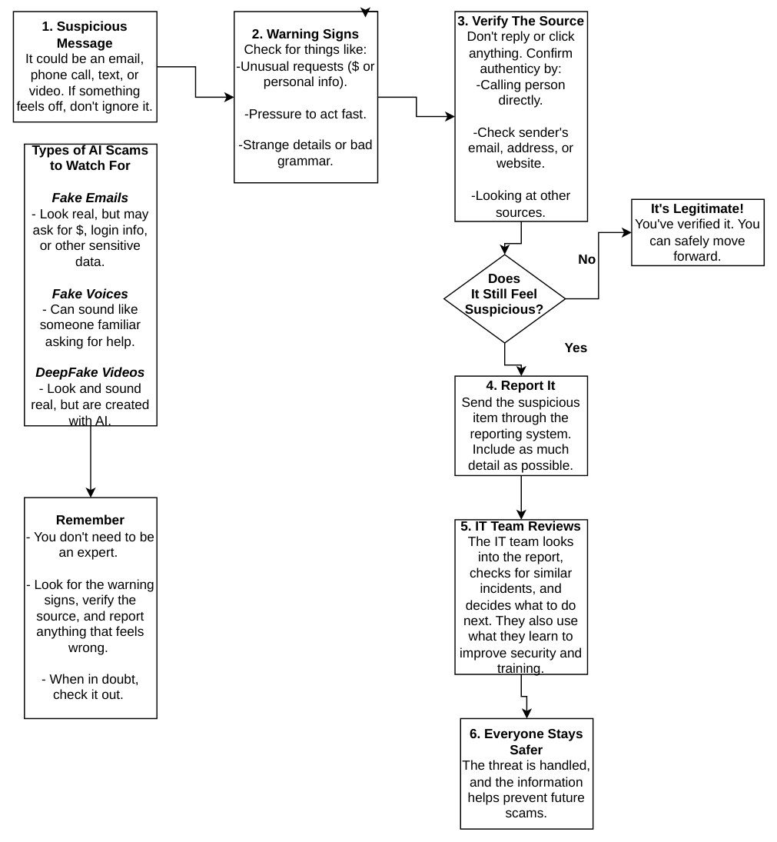
Flowchart
What to do when a message seems suspicious
3

Slide 4
Sample Scam Reporting Form
Employees can fill in the boxes below to describe a suspicious message.
Your name
Date and time received
Click here and type your answer
Click here and type your answer
Type of suspicious message (mark one):
☐ Email ☐ Text message ☐ Phone call / voice ☐ Video ☐ Other
Who did it appear to come from?
Email address, number, or account used
Click here and type your answer
Click here and type your answer
What did the message ask you to do?
Example: Click a link, send money, or share a password
What seemed suspicious?
Example: Urgent deadline, strange address, or changed payment details
Did you click a link, send money, or share any information? ☐ No ☐ Yes ☐ Not sure
Send this form and any screenshots through your company’s approved IT reporting channel.

Slide 5
Threat Analysis Sheet
Breaking down a suspicious email
“Verify your work account today or you may lose access.”
Warning sign | What to check
Urgent deadline or threat | Do not rush; ask why it needs immediate action
Unusual email address | Compare it with the real company address
Link requesting login details | Use the known company website instead
Manager’s name on the message | Call the manager through a trusted contact
Assessment: Possible phishing email; high risk. These signs do not prove AI was used.
5

Slide 6
Scenario Walkthrough
Sarah receives a possible deepfake video requesting $4,500
Flowchart step | What Sarah does
1. Suspicious message | Receives a video asking for a $4,500 payment
2. Warning signs | Notices urgency, changed bank details, odd mouth movements
3. Verify source | Calls her manager; he says he sent no video
4. Report it | Sends the details and video to IT
5. IT reviews | IT finds similar messages and warns employees
6. Everyone stays safer | No payment is made; procedures are reviewed
Result: The payment is stopped, and IT warns other employees.
6

